Slide 1
Bio materials
By Dr. Deepali N. Kanekar

Slide 2
Bio materials
Biomaterials play an integral role in medicine today—restoring function and facilitating healing for people after injury or disease.
Biomaterials may be natural or synthetic and are used in medical applications to support, enhance, or replace damaged tissue or a biological function.
The first historical use of biomaterials dates to antiquity, when ancient Egyptians used sutures made from animal sinew.

Slide 3
Metals, ceramics, plastic, glass, and even living cells and tissue all can be used in creating a biomaterial.
They can be reengineered into molded or machined parts, coatings, fibers, films, foams, and fabrics for use in biomedical products and devices like heart valves, hip joint replacements, dental implants, or contact lenses.
They often are biodegradable, and some are bio-absorbable, meaning they are eliminated gradually from the body after fulfilling a function.

Slide 4
Metals and alloys for biomedical applications
METALS AND ALLOY are extensively used as biomaterial for their excellent strength and biocompatibility.
We will discuss about types of metal alloys used as surgical implants.
Research is still continue to develop metallic biomaterials with the highest biocompatibility and least toxicity. M

Slide 5
STAINLESS STEEL
ALLOY of Fe,, Cr, Ni and C.
It has good corrosion resistance due to formation of passive layer on these material (due to Cr).
Used as permanent surgical implant for decades. Eg. 316 L (316 LOW CARBON STEEL)
The biocompatibility in this implants due to protective layer of Chromium oxide.
The advantages of SS are that it is cheap, easily available and has excellent fabrication properties, is biocompatible and has great strength.

Slide 6
Most of internal fixation devices like wires, pin, screws, plates, and intramedullary nails or rods are made up of SS.
Limitation:
Within the body, the SS implants are exposed to rather complex body fluids, which contain chloride ions, reduced sulfur, etc. and when SS reacts with these ions, toxic elements like nickel and chromium are released. (to over counter these alloy can coated with transition metal nitrides eg. TiN, VN, TiAIN)

Slide 7
Another major concern in using SS as a biomedical implant is the presence of nickel, which is toxic, and many patients are nickel sensitive. Research is also going on in developing nickel-free SS. Nitrogen, which is also an austenite stabilizer like nickel, is being used instead of nickel.

Slide 8
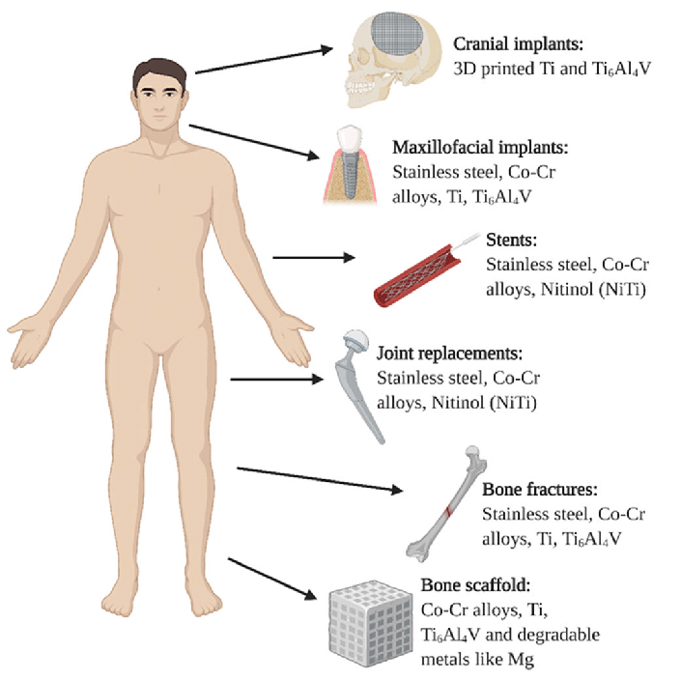

Slide 9
Cobalt- chromium alloys
The alloys are generally combination of cobalt, chromium, and molybdenum, or cobalt, nickel, chromium, and molybdenum.
They are often used as components in modular prosthetic devices such as hip or knee joints, particularly in the ball and socket joint where movement occurs.
Other applications of this alloy include implants like tibial trays, acetabular cups, dental parts, pacemaker lead casings, as well as cardiovascular stents.

Slide 10
